Slide 1
Applied Data Science with R Capstone project
Brian Seko
August 2023

Slide 2

Outline
Executive Summary
Introduction
Methodology
Results
Conclusion
Appendix

Slide 3

Executive Summary
Focus: Optimize bike rental supply for better availability and accessibility.
Data Methods: Used standardized and normalized data, scraped Wikipedia for bike-sharing trends.
Key Findings:
Peak Months: June and September see highest rental rates.
High Demand Hours: 6am to 8pm.
Key Variables: Weather conditions, specifically temperature and rainfall, influence demand the most.
Demand Fluctuations: Typical rentals range from 200-300, but can spike to 3500.
City Trends: Similar cities in terms of population and climate show comparable rental patterns.
Impact: Supply adjustments based on predictive analytics can reduce operational costs.

Slide 4

Introduction
Urban Bike Rentals
Critical for city mobility
Need to balance availability & accessibility
Challenge
Oversupply = High Costs
Undersupply = Lost Revenue
Solution
ML model to predict hourly demand
Key Predictors
Weather
Season
Hour of Day

Slide 5

Methodology
Perform data collection
Perform data wrangling
Perform exploratory data analysis (EDA) using SQL and visualization
Perform predictive analysis using regression models
How to build the baseline model
How to improve the baseline model
Build a R Shiny dashboard app

Slide 6
Methodology

Slide 7
Data collection
Data Sources for Bike Sharing Demand
Seoul Bike Sharing Dataset
Weather Metrics: Temp, Humidity, Windspeed, etc.
Data Retrieval: Utilized download.file function for dataset acquisition.
Source: IBM Cloud Storage
Open Weather API Data
Provides: 5-day forecast for multiple cities
Method: HTTP requests to API, stored in data frame
Tools: JSON parsing, HTTP GET loop, saved to CSV
Source: OpenWeather
Global Bike Sharing Systems Dataset
Content: Active bike-sharing programs globally

Slide 8
Data collection
Data Collection Methods
Wikipedia Bike-Sharing Data
Approach: Web scraping using read_html, html_node, and html_table
Output: Data saved to CSV
Source: Wikipedia
World Cities Data
Approach: Used download.file for data acquisition
Content: Major cities' name, latitude, longitude
Source: IBM Cloud Storage

Slide 9
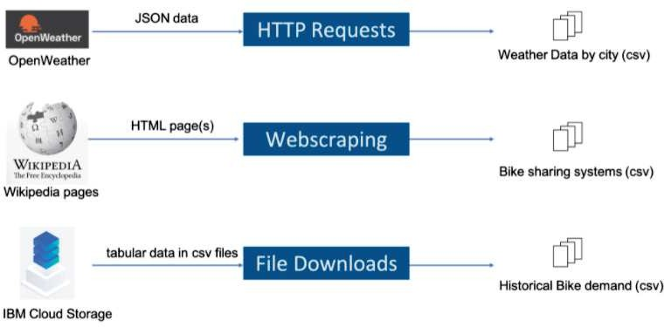
Data collection

Slide 10
Data wrangling
Advanced Data Wrangling Techniques
Tools & Libraries
Utilized stringr library and Regular Expressions for text manipulation and cleaning.
Column & Variable Normalization
Unified column names across datasets.
Used str_replace_all to replace spaces in variable names with underscores, ensuring data consistency.
Cleaning 'raw_bike_sharing_systems.csv'
Purged unwanted reference links using tailored regular expressions.
Employed str_replace_all to substitute reference link markers [...] with blank spaces, simplifying the data.
Numerical Data Extraction
Isolated numerical values embedded within text in the 'raw_bike_sharing_systems.csv' dataset.
Utilized str_extract to capture and isolate the first number in each relevant field for easier analysis.
Goal: To create a clean, standardized dataset for efficient and accurate downstream analysis.

Slide 11
Data wrangling
Data Wrangling in 'raw_seoul_bike_sharing.csv'
Tools Used: dplyr library
Handling Missing Values
Target Variable: TEMPERATURE
Method: Used is.na filter to identify missing values.
Imputation: Replaced missing values with the mean of existing values.
Data Normalization
Approach: Min-Max Normalization
Execution: Utilized mutate to apply normalization to selected variables.
Goal: To create a standardized, complete dataset for more accurate analysis.

Slide 12
EDA with SQL
Metrics
Total & active rental hours
Peak Time
Max rental date & hour
Weather Data
3-hr interval focus
Seasonal Scope
Dataset's date range & covered seasons
Rentals & Weather
Sort by avg. bike count
Target Cities
15-20K bikes, with geo & pop data
Seasonal Trends
Top 10 avg. hourly rentals & temps
Seoul Bike Inventory
Joined city & bike tables, key stats
Goal: Uncover key insights for optimizing bike rentals.

Slide 13
EDA with data visualization
Scatter Plots
Rented Bike Count vs. Date, colored by Hour
Correlation between Bike Count & Temp, segmented by Seasons
Histogram
With Kernel Density Overlay
Boxplots
Bike Count vs. Hour, grouped by Seasons
Aggregated Metrics
Daily Rainfall & Snowfall via summarize()
Objective: Unveil patterns and correlations for informed decisions.

Slide 14
Predictive analysis
The primary goal here is to construct a robust linear regression model that accurately predicts hourly bike-sharing demand, focusing mainly on weather and datetime variables.
The Basics: Linear Models
First things first, we split our data into training and testing datasets. With this data, we go ahead and build two distinct models:
Model 1: This one uses only weather-related variables.
Model 2: A more comprehensive model, incorporating both weather and datetime variables.
Taking It Up a Notch: Model Enhancement
No model is perfect right off the bat, so we improve ours by adding some complexities:
Polynomial Terms: For capturing curvilinear relationships.
Interaction Terms: To understand how combined variables affect the output.
Regularization: To penalize overly complex models and prevent overfitting.

Slide 15
Predictive analysis cont.
The Metrics Game: Evaluating Success
To determine the best model among the contenders, we deploy some time-tested evaluation metrics like R-squared and RMSE. We even add a little flair by generating a bar graph to compare the predictor variable coefficients.
The Final Lap: Optimization
It's all about tweaking and fine-tuning to get that perfect model. Through experimentation and maybe a bit of luck, we aim to land on the most efficient and accurate model to predict hourly bike demand.
The End Goal
The entire exercise aims to pinpoint the optimal model, allowing for highly accurate hourly bike demand predictions. This could be a game-changer in optimizing bike-sharing services, especially in cities where this is a popular form of transport.

Slide 16
Build a R Shiny dashboard
R Shiny App for Bike Forecasting
Dive into an interactive Leaflet map that comes alive with a city-specific dropdown.
Visualize the scene with ggplot graphs, showing not just bike demand but also temperature trends for your chosen city.
Enhance your experience with city detail plots and straightforward trend lines for temperature and demand.
Get hands-on with dynamic demand predictions and peek into how humidity correlates with bike-sharing needs.
End Game: A one-stop, user-friendly app offering razor-sharp insights into bike-sharing demand.

Slide 17
Results
Exploratory data analysis results
Predictive analysis results
A dashboard demo in screenshots

Slide 18
EDA with SQL

Slide 19
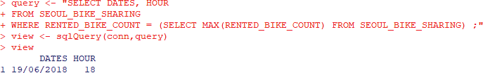
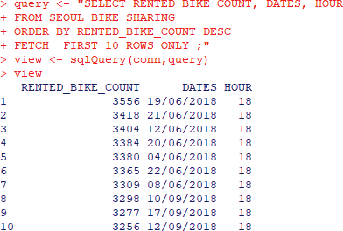
Busiest bike rental times
The peak in bike rentals was observed in June 2018, hitting a staggering 3,556 rentals at 6 pm.
Summer months consistently show elevated levels of bike rentals, reinforcing seasonal trends in user behavior.
Takeaway: The data suggests that strategic planning for bike availability is crucial, especially for high-demand periods like summer evenings.

Slide 20
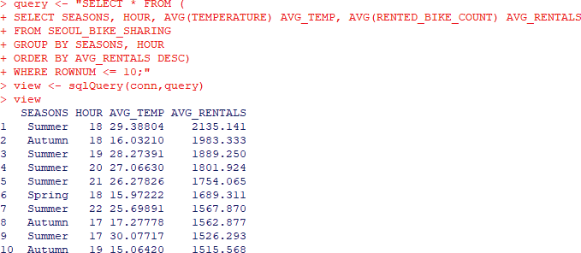
Hourly popularity and temperature by seasons
Bike rentals hit their stride at two key times across all seasons: the morning rush at 8 am and the evening commute at 6 pm.
These time slots consistently rack up the highest average rentals, making them critical hours for supply optimization.
Takeaway: Whether it's winter or summer, 8 am and 6 pm are the hotspots for bike rentals. Adjusting supply for these peak times could maximize both availability and revenue.

Slide 21
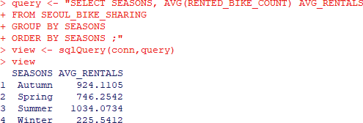
Rental Seasonality
Across all seasons, analyzing the average hourly bike count reveals distinct trends.
Summer stands out as the prime time for bike rentals, boasting the highest average hourly counts.
In contrast, winter sees the lowest rate of bike rentals, indicating a seasonal dip in demand.
Takeaway: Seasonality plays a significant role in bike rentals, with summer being the peak period. This underscores the need for dynamic supply strategies tailored to each season.

Slide 22
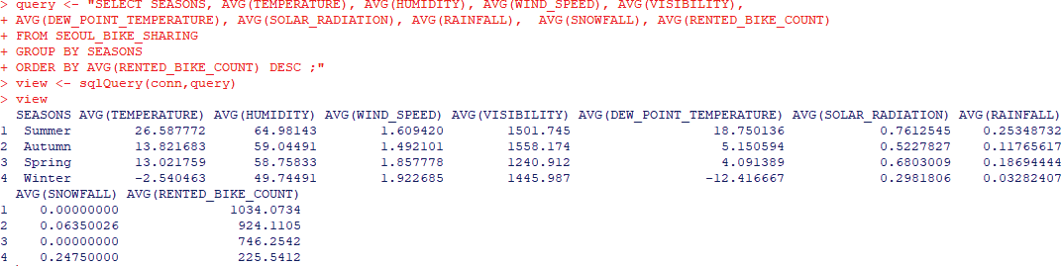
Weather Seasonality
Key variables that seem to be tightly linked with bike rentals are temperature, humidity, and dew point temperature.
Other variables don't align well with the patterns observed in average bike rentals.
Takeaway: If you're looking to predict bike rental demand, focus on temperature, humidity, and dew point as your leading indicators. The other factors may not offer the same predictive power.

Slide 23
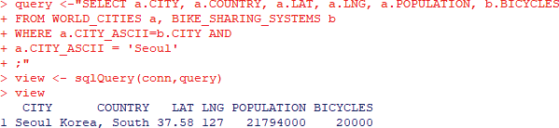
Bike-sharing info in Seoul
Seoul, situated at 37.58° latitude and 127° longitude in South Korea, is a bustling city with a population of approximately 21.8 million people.
The city is equipped with 20,000 rental bikes to cater to its residents and visitors alike.
Takeaway: With a sizeable population and a substantial number of rental bikes, Seoul presents a unique landscape for studying bike rental trends and demand.

Slide 24
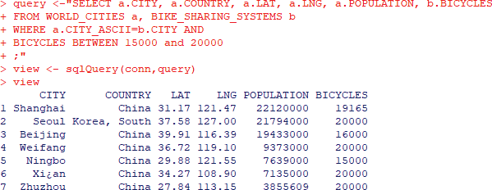
Cities similar to Seoul
This query highlights cities with a total bike count ranging between 15,000 and 20,000.
Included are details such as city and country names, geographical coordinates (LAT, LNG), population figures, and the exact number of available rental bikes.
Takeaway: This focused query offers a snapshot of cities with similar bike infrastructure as Seoul, aiding in comparative analysis and trend prediction.

Slide 25
EDA with Visualization

Slide 26
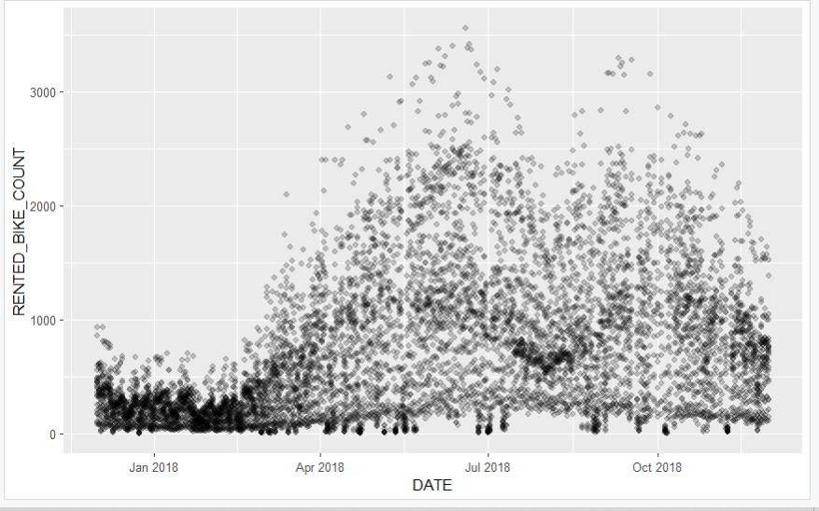
Bike rental vs. Date
A clear seasonal pattern emerges in the data for hourly rented bike counts.
Winter months record the lowest usage, often falling below 1,000 rentals per hour.
A noticeable uptick begins in spring, peaking during the June-July summer months.
Though there's a slight dip in August, a secondary peak occurs in September.
Takeaway: Understanding these seasonal trends can guide supply optimization, allowing for better planning and reduced operational costs.

Slide 27
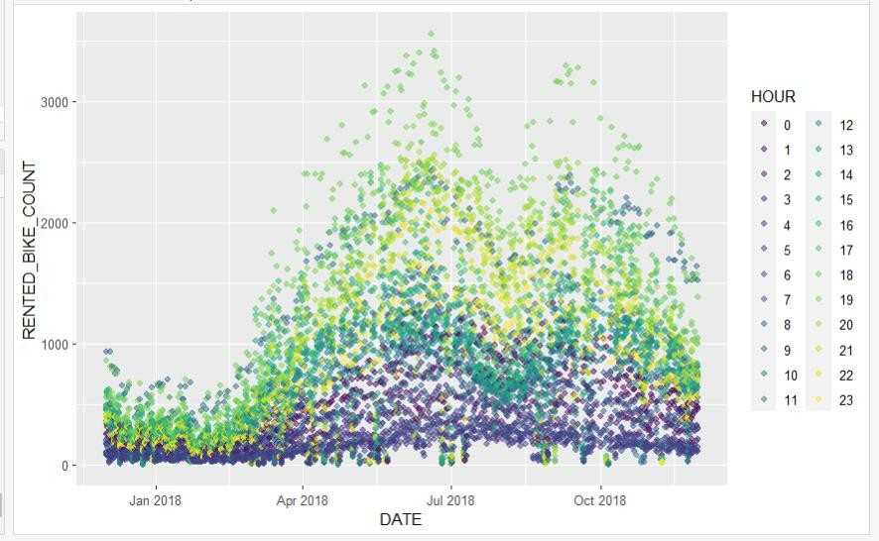
Bike rental vs. Datetime
Bike rentals are predominantly concentrated during daytime hours (12 PM onwards) and taper off significantly after midnight.
This trend is consistent and logical, as late-night and early-morning hours are typically rest periods for most people.
This pattern holds true across all seasons.
Takeaway: Awareness of these daily rental cycles can assist in optimizing bike availability and maintenance schedules.

Slide 28
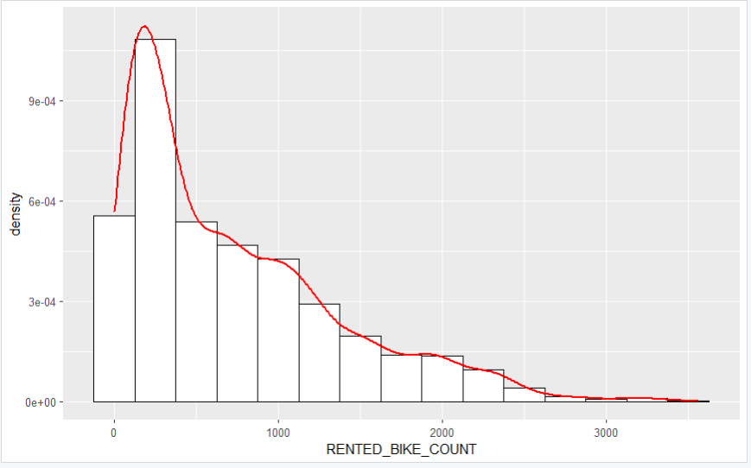
Bike rental histogram
The histogram reveals a mode around 250 bikes, indicating that most of the time, bike rentals hover around this number.
However, we also spot some irregularities—additional 'bumps' at about 700, 900, 1900, and 3200 bikes suggest multiple modes or peaks within subgroups.
The tail of the distribution hints at outlier events where bike rentals shoot up far above the norm.
Takeaway: While the typical demand is moderate, there are specific instances or conditions that trigger significantly higher bike rentals. This suggests room for further investigation to pinpoint these demand drivers.

Slide 29
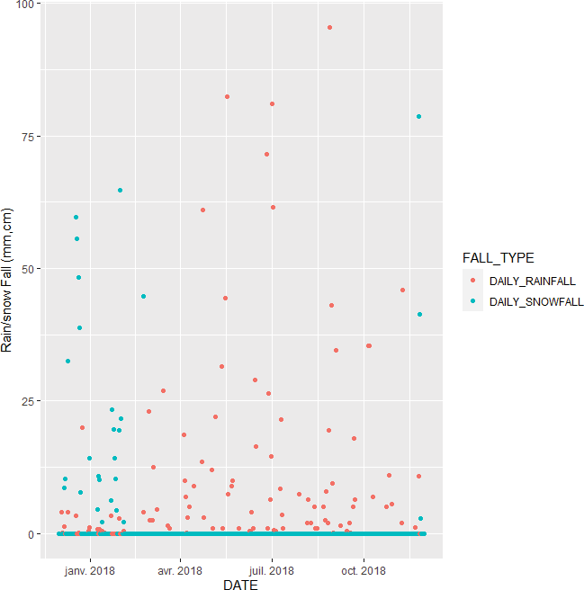
Daily total rainfall and snowfall
As expected, snowfall mainly occurs in winter, while rainfall is spread throughout the rest of the year.
Generally, the climate is dry; there's often no rain or snow.
In the given year, about 30 days experienced snowfall and around 100 days had rainfall.
Takeaway: The majority of days are precipitation-free, but when it does happen, it's more likely to be rain than snow. This could influence bike rental patterns and should be considered in demand forecasting.

Slide 30
Predictive analysis

Slide 31
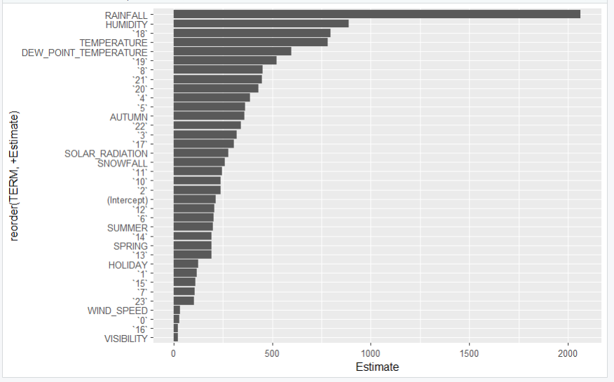
Ranked coefficients
Top factors for bike rental prediction in Seoul: Rainfall, 6pm time slot, Humidity, and Temperature.
These factors vary across seasons, adding a layer of complexity to the prediction model.
Takeaway: These dynamic variables partly explain the seasonal patterns in bike rentals. For more accurate predictions, these should be key considerations in the model.

Slide 32
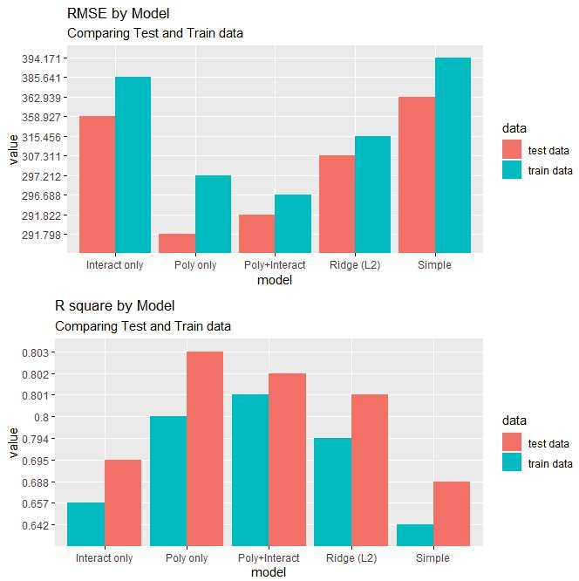
Model evaluation
A deep dive into the residuals indicated the need for a log transformation on the predicted variable for better model fit.
Post-transformation, linear regression assumptions are better met.
Going forward, "RENTED_BIKE_COUNT" will represent the log-transformed counts.
Takeaway: Model 2 performs the best, particularly after the log transformation. Keep this in mind for subsequent analysis.

Slide 33
Find the best performing model
Top Performers: Three models—Poly only, Poly+Interact, and Ridge (L2)—have an RMSE under 330 and R-squared above 0.72.
Our Pick: Going for simplicity and effectiveness, the Polynomial-only model stands out.
Model Formula:
RENTED_BIKE_COUNT ~ . + poly(RAINFALL, 3) + poly(HUMIDITY, 3) + poly(TEMPERATURE, 3) + poly(DEW_POINT_TEMPERATURE, 3)
Key Takeaway: The Polynomial-only model offers the best balance of accuracy and simplicity.

Slide 34
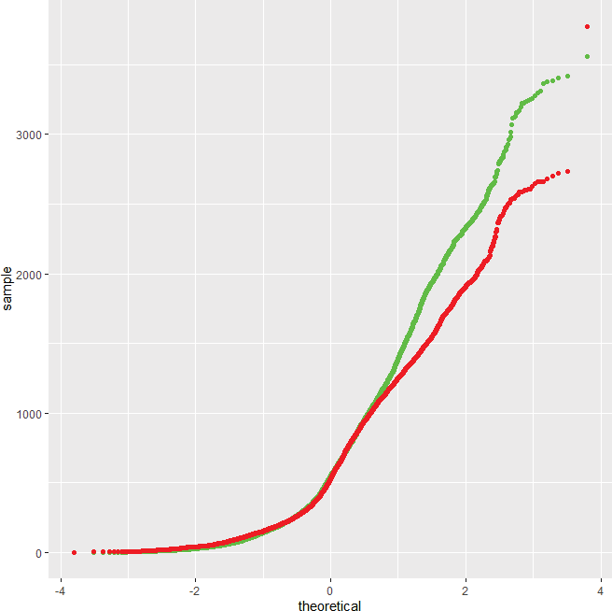
Q-Q plot of the best model
•Model performance
Prediction
Truth

Slide 35
Dashboard

Slide 36
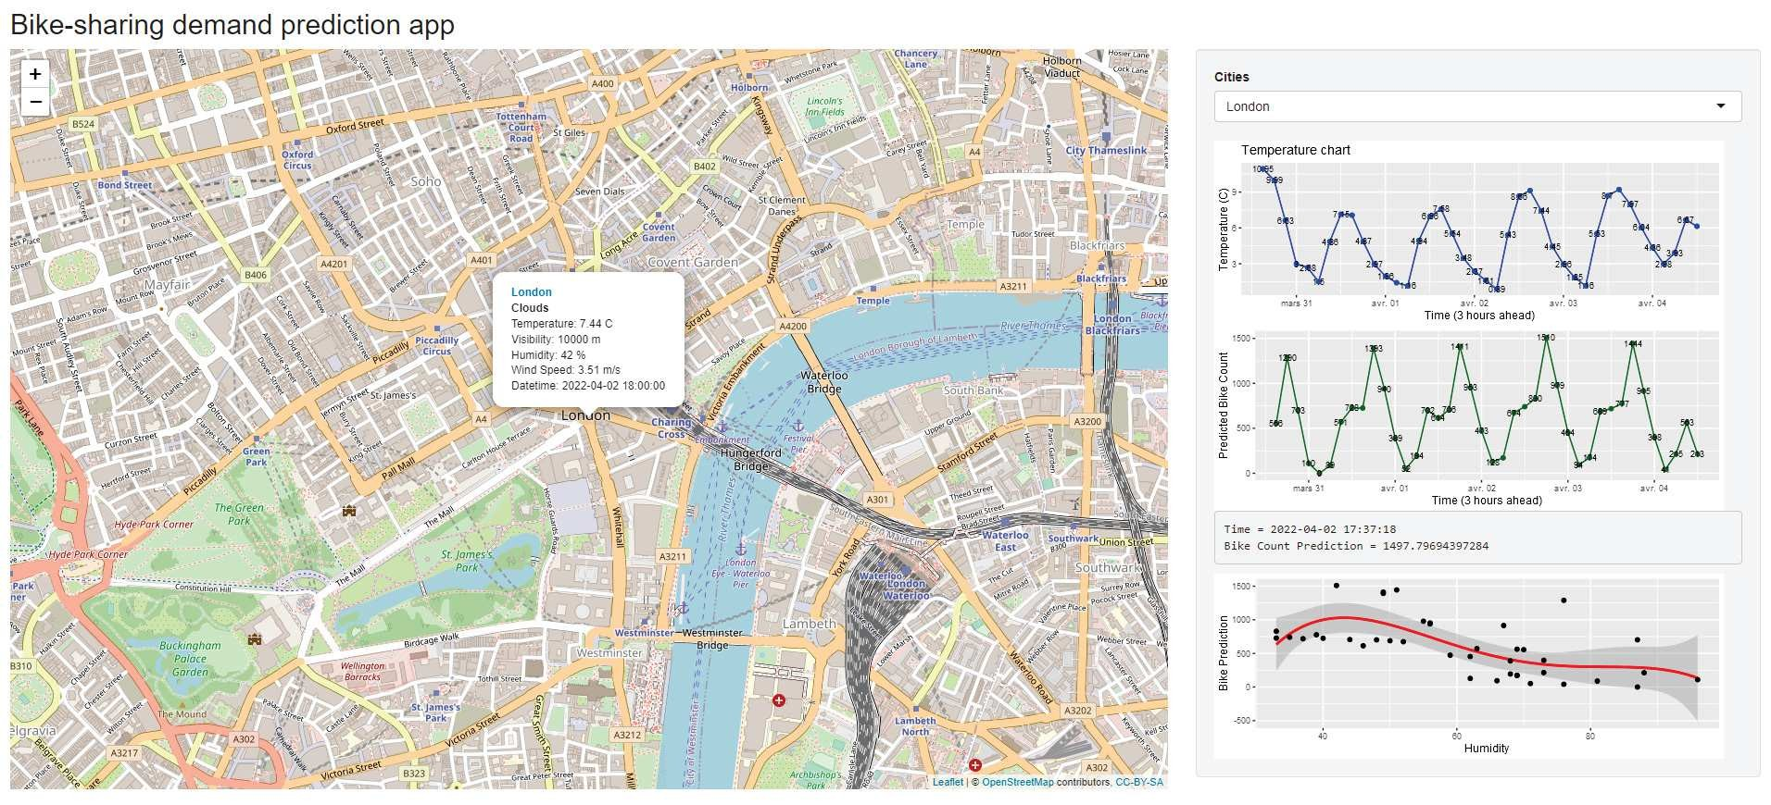
Bike-sharing demand prediction for city : London

Slide 37
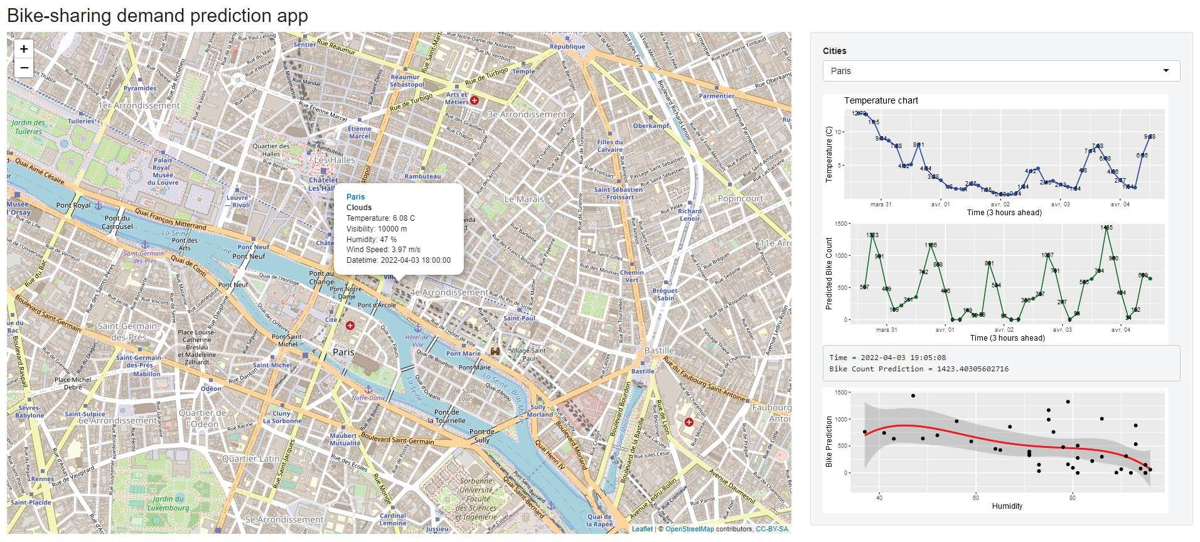
Bike-sharing demand prediction for city : Paris

Slide 38

CONCLUSION
Typical Scene: Rentals usually hover around 200-300 bikes.
Weather & Time: Favorable conditions and peak hours can spike rentals to 3,500.
Seasonal Trends: Summer and Autumn see the most action, with June and September as peak months. Winter's a slow season.
Prime Time: 6am and 8pm are the hotspots for rentals.
Key Factors: Temperature and weather conditions like Humidity/Rainfall heavily influence rentals.
One Size Doesn't Fit All: Similar cities may have similar patterns, but always check the local data.
Business Impact: Aligning bike supply with our dashboard predictions could cut costs and better meet customer demands.

